Slide 1


Housing Price Prediction
By
Dhrubajyoti Mandal

Slide 2

Content
Problem Statement
Data Preprocessing
Exploratory Data Analysis
Feature Engineering
Model Building
Hyper Parameter Tuning
Saving The Model
Predicting Test Set

Slide 3
Problem Statement
A US-based housing company named Surprise Housing has decided to enter the Australian market. The company uses data analytics to purchase houses at a price below their actual values and flip them at a higher price. For the same purpose, the company has collected a data set from the sale of houses in Australia. The data is provided in the CSV file below.
The company is looking at prospective properties to buy houses to enter the market. You are required to build a model using Machine Learning in order to predict the actual value of the prospective properties and decide whether to invest in them or not. For this company wants to know:
• Which variables are important to predict the price of variable?
• How do these variables describe the price of the house?

Slide 4
Data Preprocessing
The shape of the data set
* Train dataset – (1186 , 81)
* Test dataset – (290 , 80)
Treated all the null values present in the data set with
* Mean – numeric features
* Mode – categorical features

Slide 5

Exploratory Data Analysis ( EDA)

Slide 6
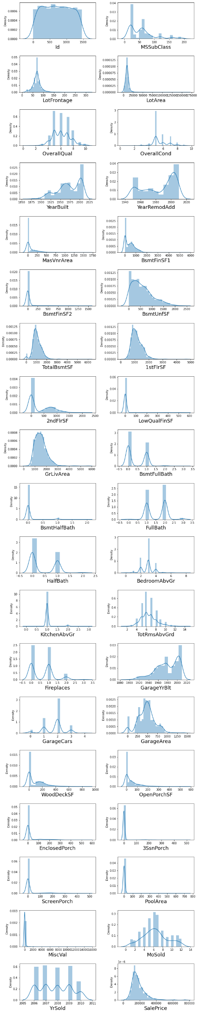
OBSERVATION:
1. FV is highest in price followed by RL and RH.
2. Streets having Pave and Alley having Grvl is having high Price.
3. LotShape of IR2 is high in Price.
4. LandContour with HLS ,LotConfig with FR3,LandSlope woth Sev are having higher prices than the other subcategories.
5. Condition 1 withRRNn nad PosA have high price.
6. Condition2 with PonA follewd by PosN are having prices.
7. BldgType of Twnhse,HouseStyle of 2.5Unf,RoofStyle of Shed, RoofMatl of Wdshngl, Exterior1st of
stone and Imstucc are high prices whereas Exterior2nd with other and Imstucc have high price.
8. MasVnrType with stone, ExterQual with Ex,ExterCond withEx,Foundation with Pconc, BsmtQual with ex
BmstCond with Gd,BmstExposer with Gd,BsmtFinType1 with GQL,BsmtFinType2 with GQL andAQL are
high in Price.
9. Heating with GasA ,HeatingQc with Ex,CentralAir with Yes Electrical with SBrkr, KitchenQual with
Ex ,Funtional with Typ,FireplaceQu with Ex, GarageType with BuiltIn, GarageFinish with Fin has
high Price.
10. GarageQual with Ex,GarageCond with Gd,PavesDrive with Y,PoolQc with Ex ,Fence with MnPrv nad
GdPrv are high in Price.
11. SaleType of con and new ,SaleCondition with Partial are having highest SalePrice.

Slide 7
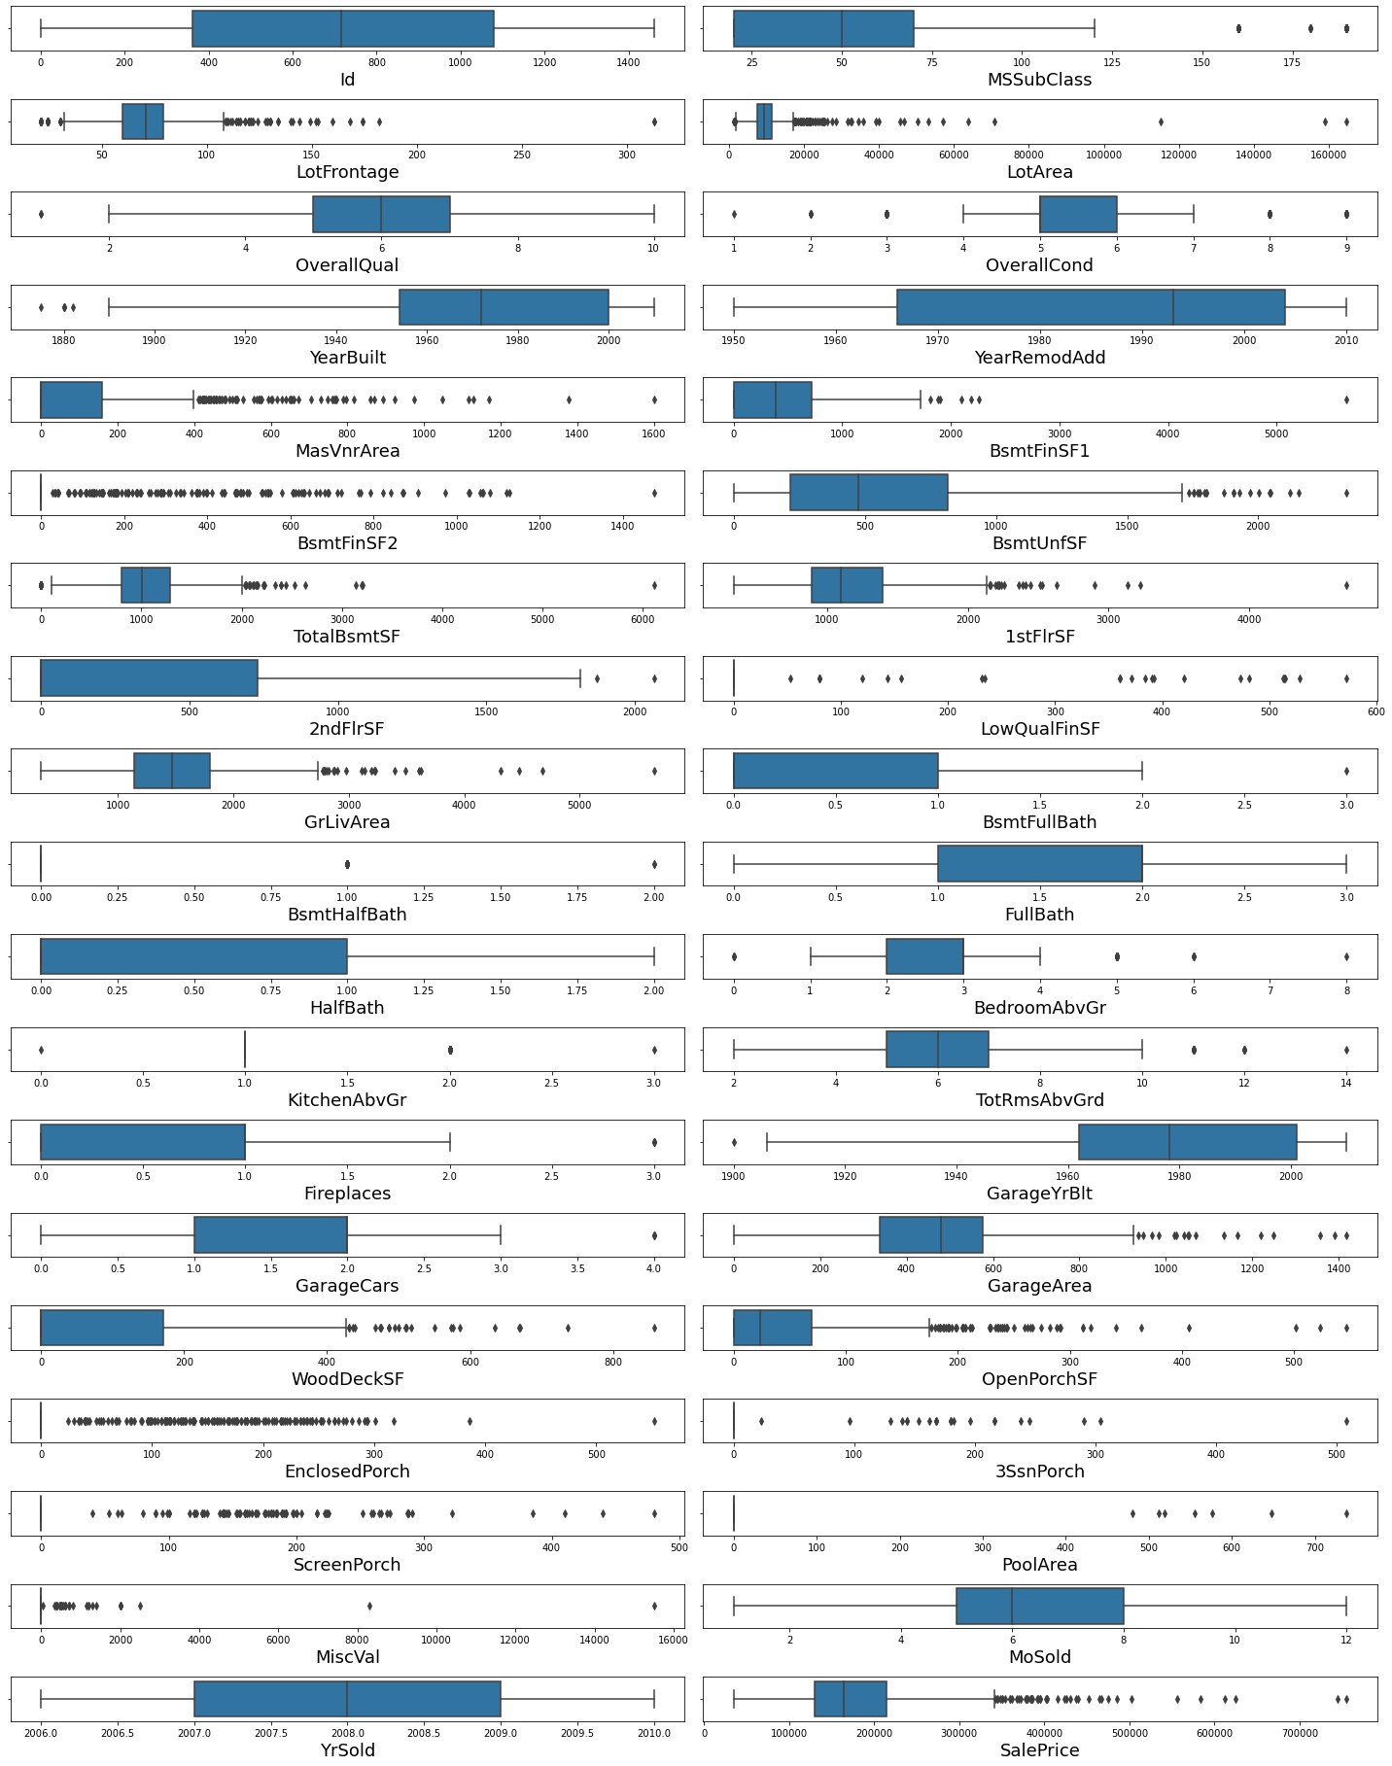

OBSERVATION:
1. Some features such as Id, YearRemodAdd,BsmFullBath,FullBath,HalfBathFirePlace,MoSold,YrSold are not having outliers.
2. Rest of the features are more or less having outliers .
3. Many features are skewed
4. Some of the features are following standard deviation curve

Slide 8
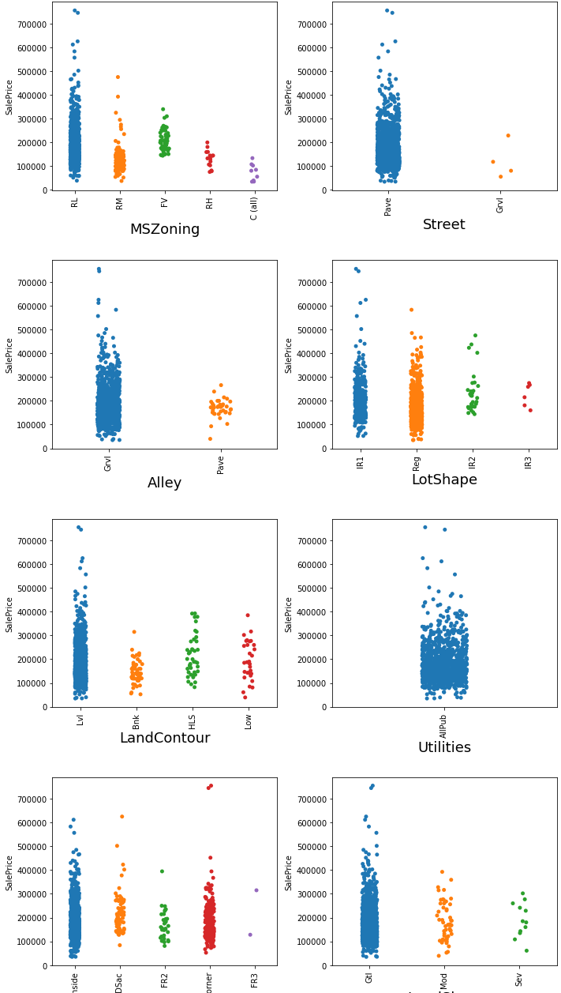
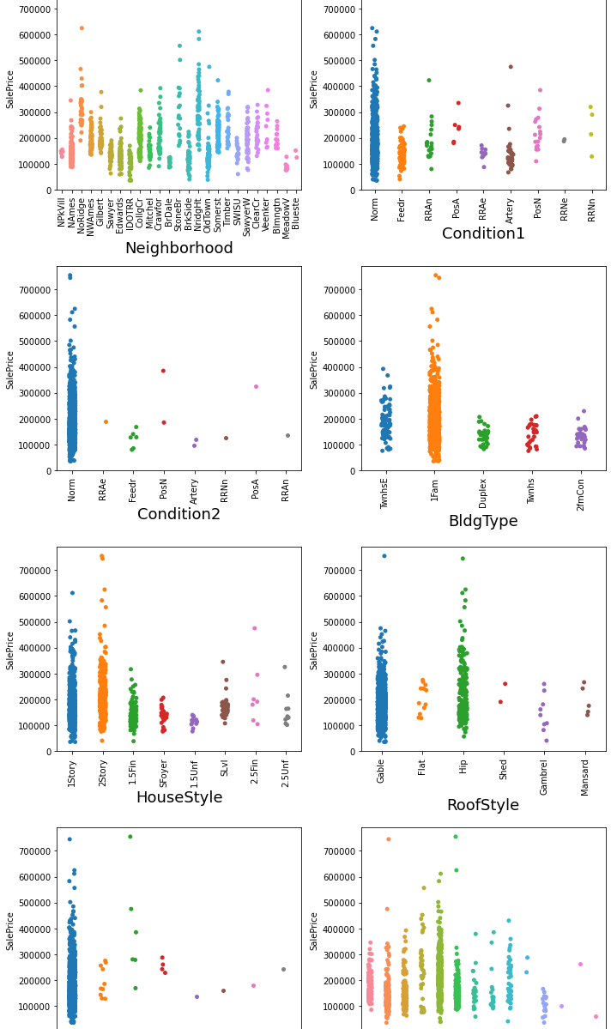
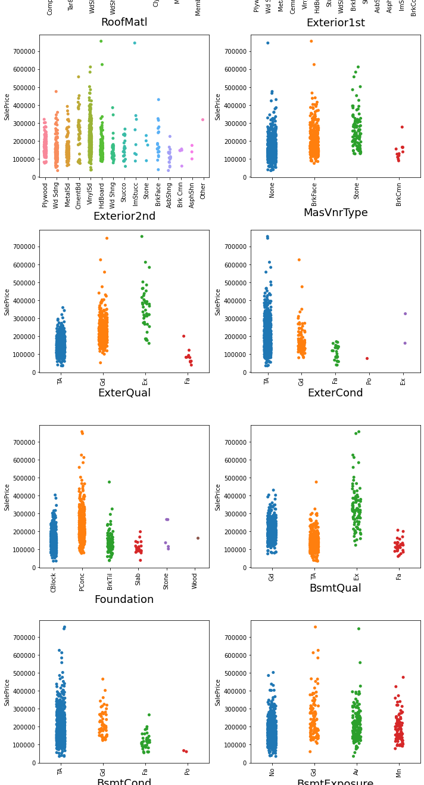

Slide 9
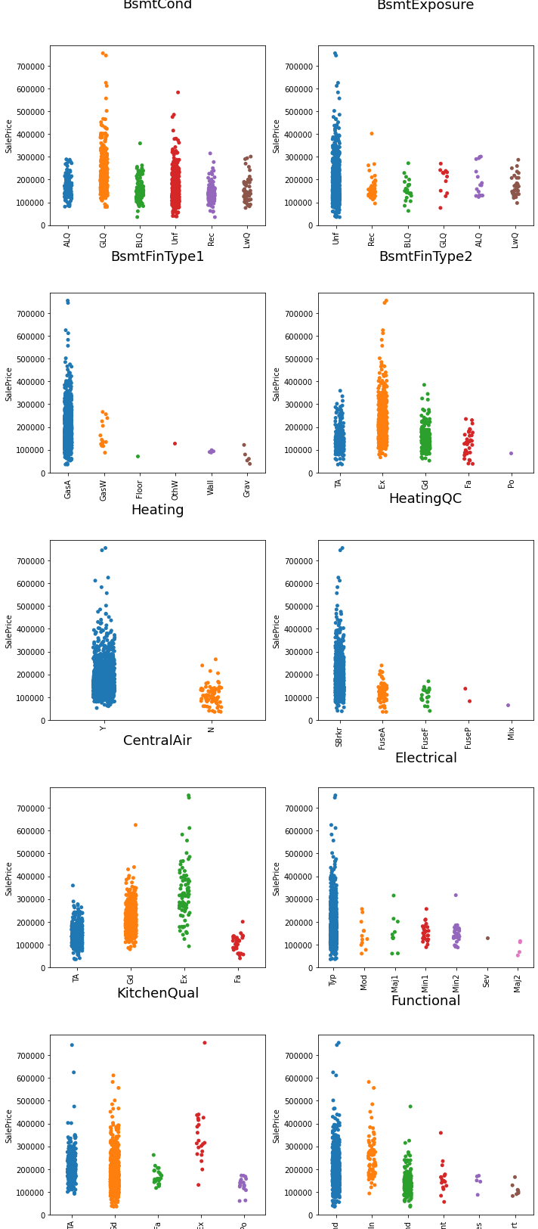
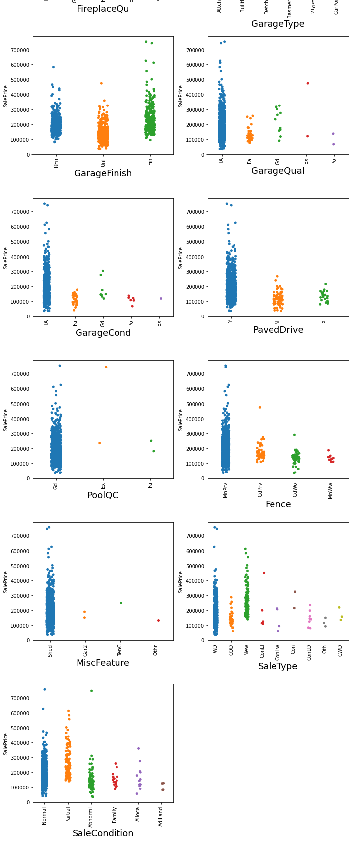

Slide 10
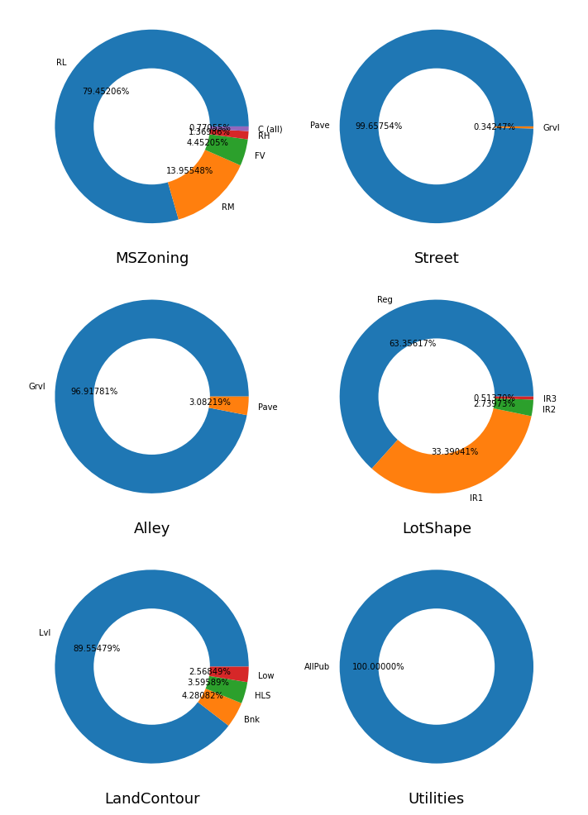
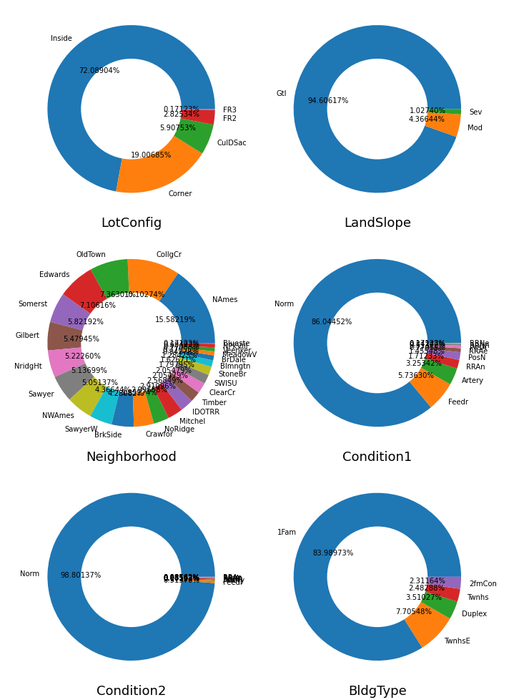

Slide 11
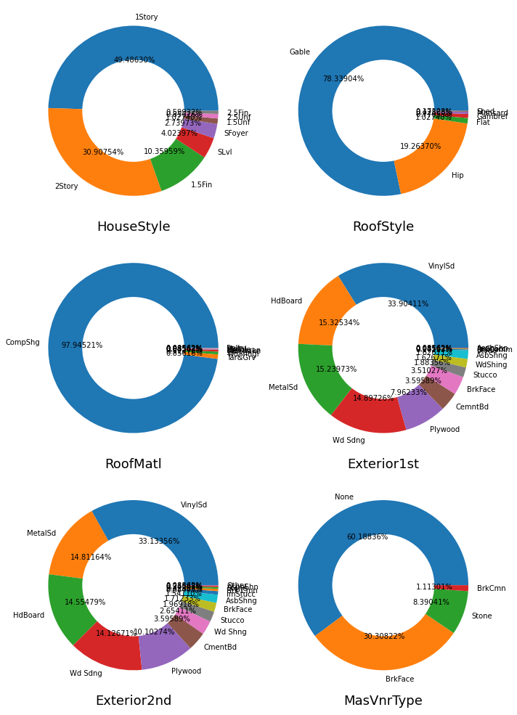
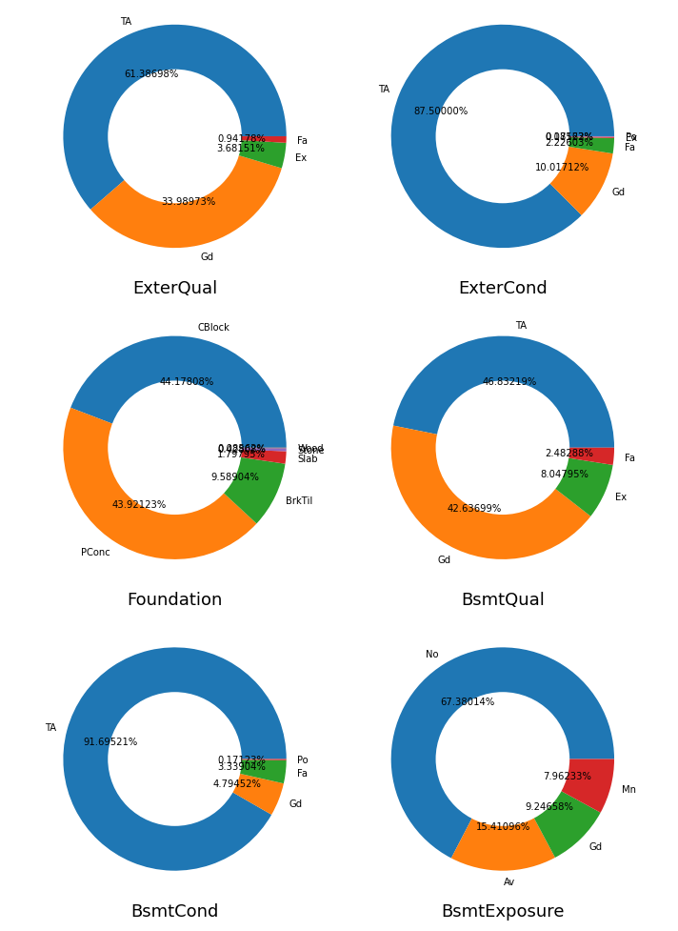

Slide 12
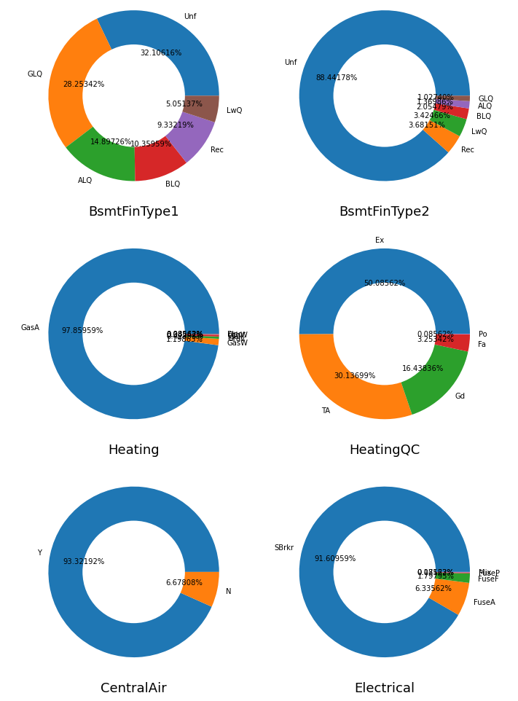
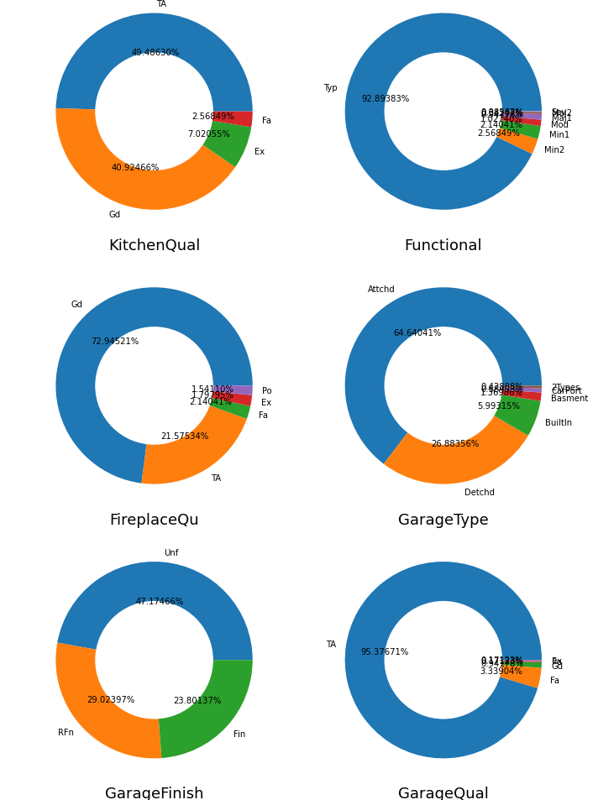
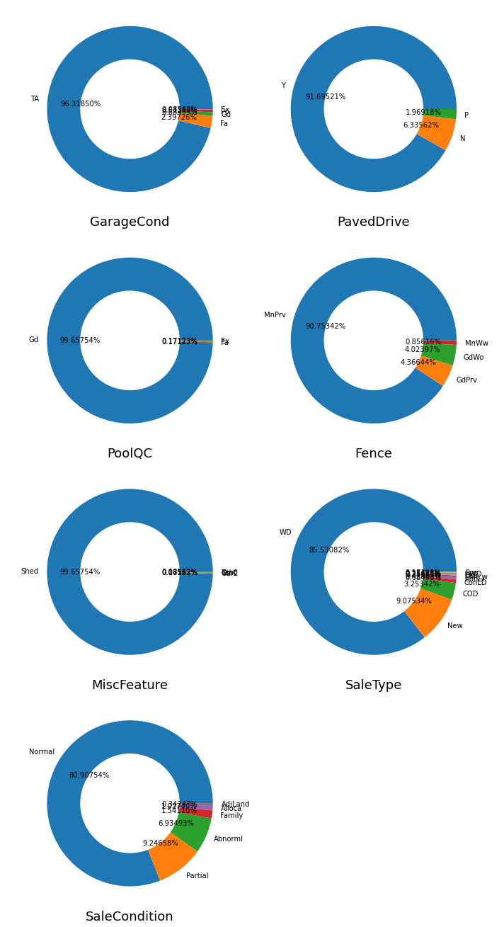

Slide 13
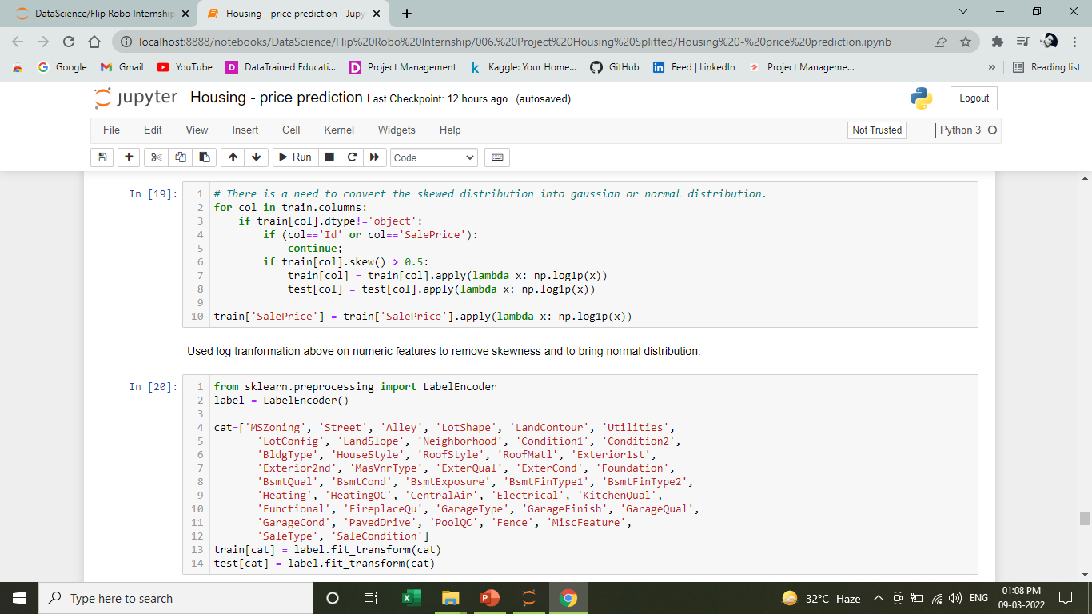
Feature Engineering
Used Log transformation for removing outliers and skewness

Slide 14
Feature Engineering
Used LabelEncoder for encoding every categorical features to encode with numeric codes.

Slide 15
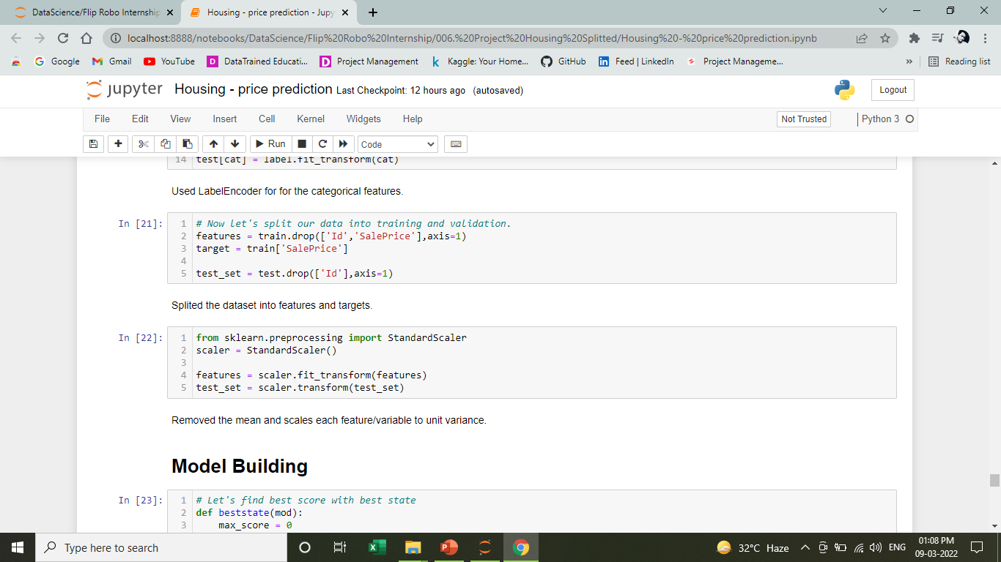
Feature Engineering
Split the dataset for training and testing
Removed the mean and scales each feature/variable to unit variance.

Slide 16



Ready for building Machine Learning Model

Slide 17

Algorithms used:
K-Neighbors Regressor
Decision Tree Regressor
Support Vector Machine
Random Forest Regressor
Gradient Boosting Regressor

Slide 18
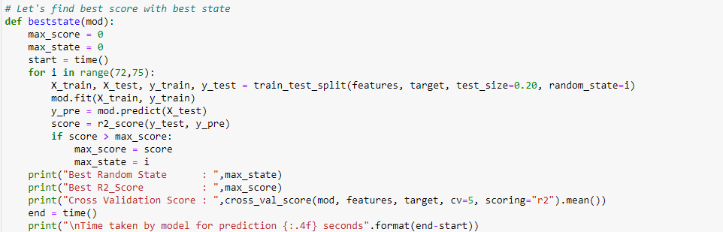
Model Building
From the dataset we can infer that it is clearly a regression problem.
Define a function from which different algorithms will be called.

Slide 19
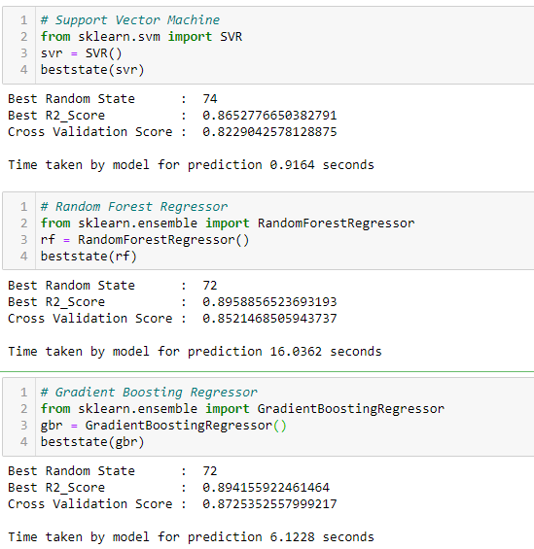
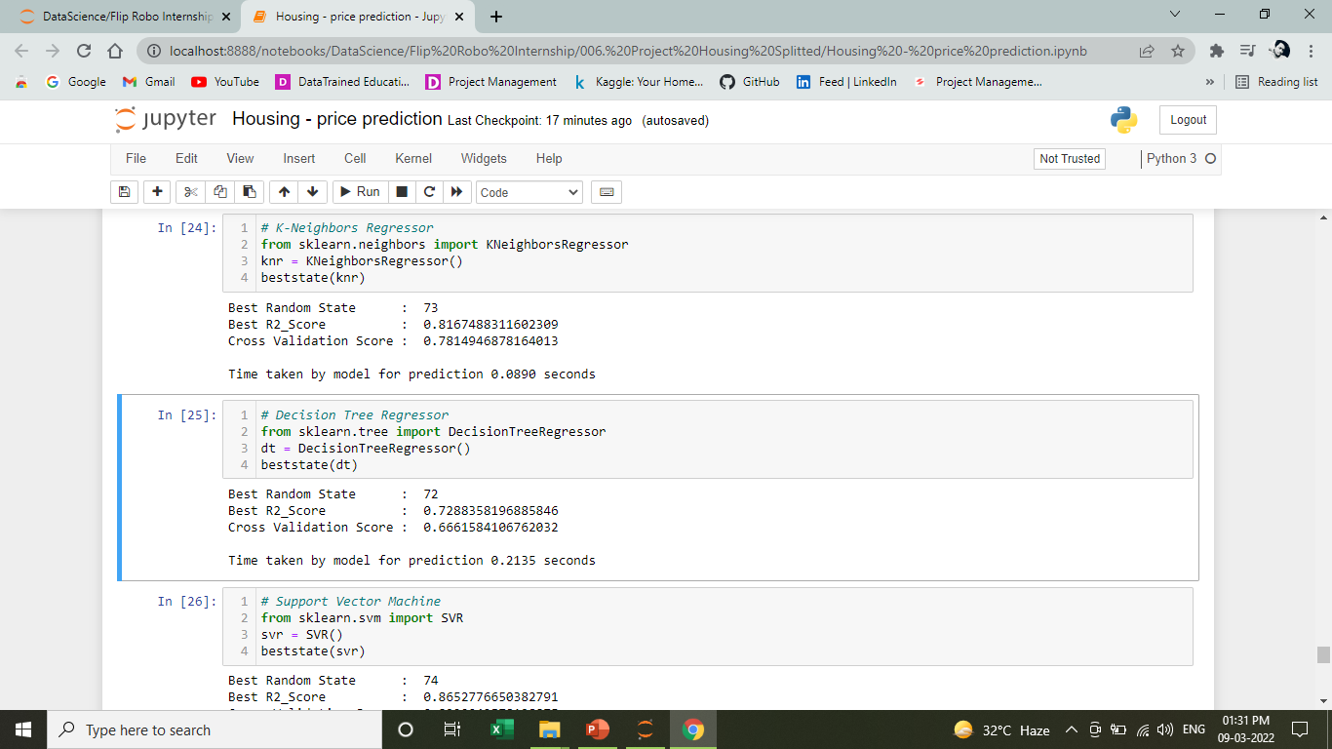
Algorithms

Slide 20
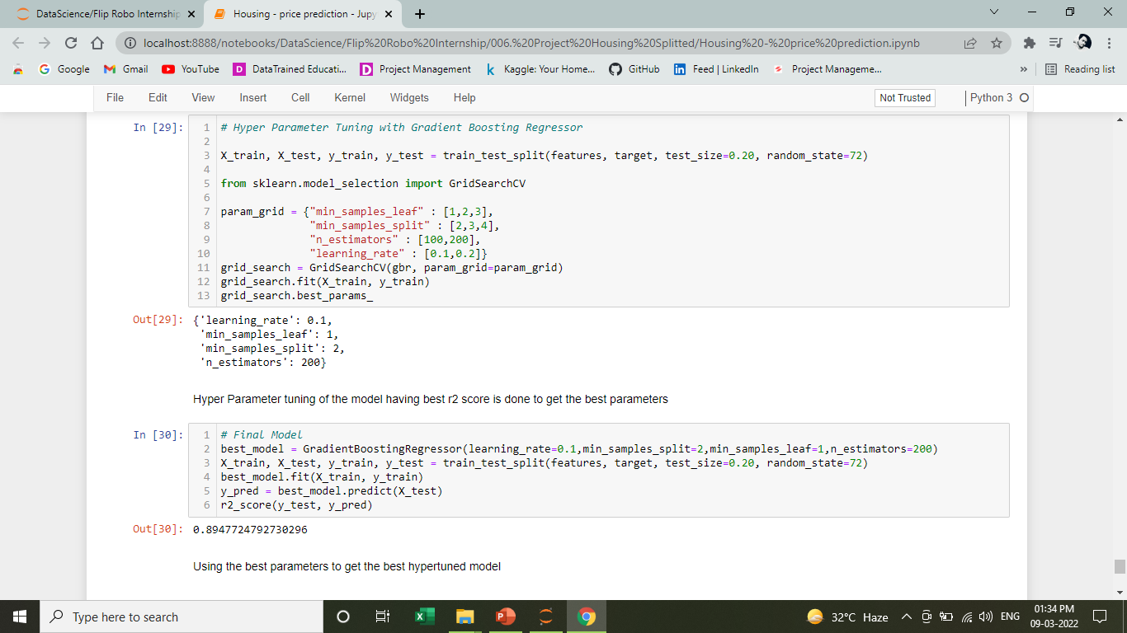
Hyper Tuning the Model

Slide 21
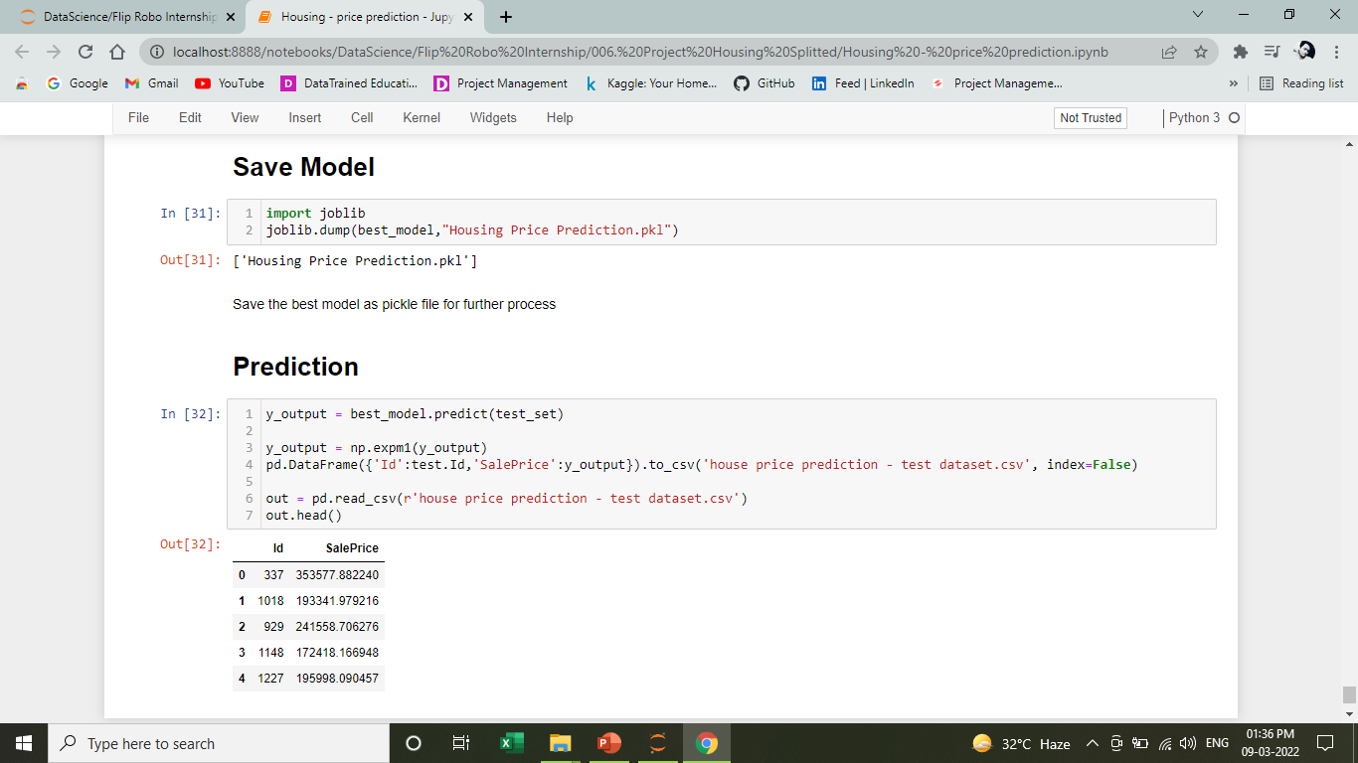
Saving the Model
Saving the model in pickle format with the help of joblib library for further process and deployment

Slide 22
Conclusion
Predicting the test dataset and view the first five prediction
Saving a .csv file for storing the predicted Sale Price of the House

Slide 23

Thank You

